Slide 1
SwipeLab- PROPOSAL Sagi Evroni, Eden Bar, Ofri Hanochi, Avihoo Amos
Software Engineering
Faculty of Engineering
Ben Gurion University of the Negev

Slide 2
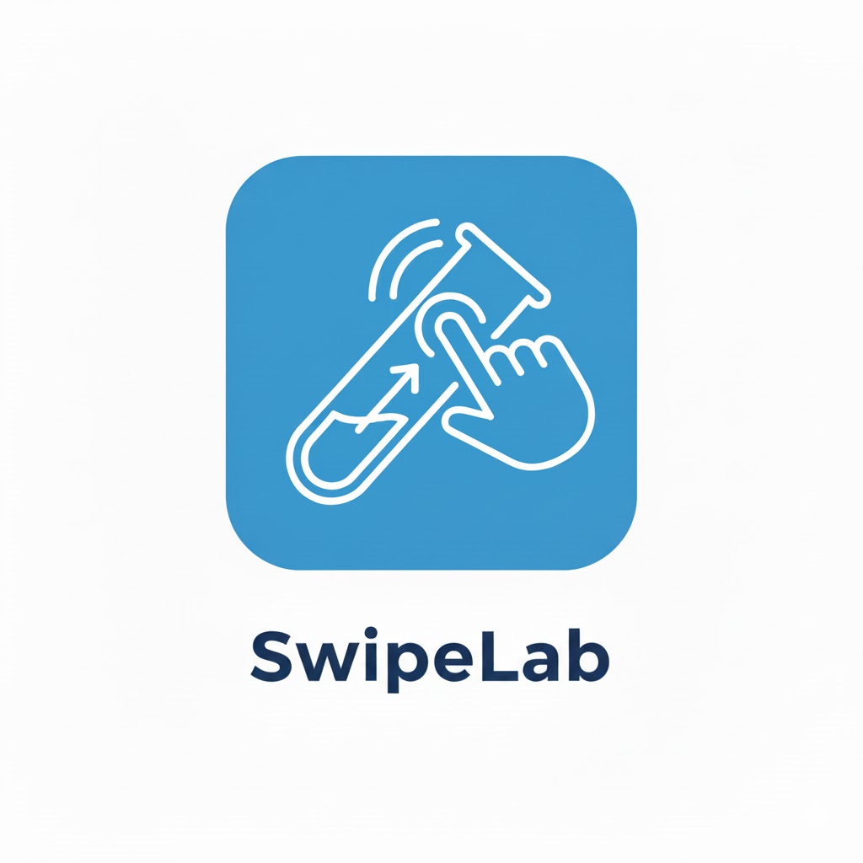

SwipeLab
SwipeLab
סְוּוָיְיפְּלֵאבּ
Student Name | ID | Email | Phone | Signature
Israel Israeli | 12345678 | israel@post.bgu.ac.il | ?? | Add Sign
Student Name | ID | Email | Phone | Signature
Sagi Evroni | 315231969 | evronis@post.bgu.ac.il | 0523777066
Eden Bar Ofri Hanochi | 316293026 205614894 | barede@post.bgu.ac.il ofrihano@post.bgu.ac.il | 0526020195 0524704015 | Add Sign Add Sign
Avihoo Amos | 208142844 | avihooa@post.bgu.ac.il | 0544884639 | Avihoo Amos

Slide 3

Customer
Chen Keasar
Chen Keasar
Associate Professor, The Institute for Interdisciplinary Computation
Member, Statistics and Data Analysis Program
Member, School of Sustainability and Climate Change
keasar@bgu.ac.il

Slide 4

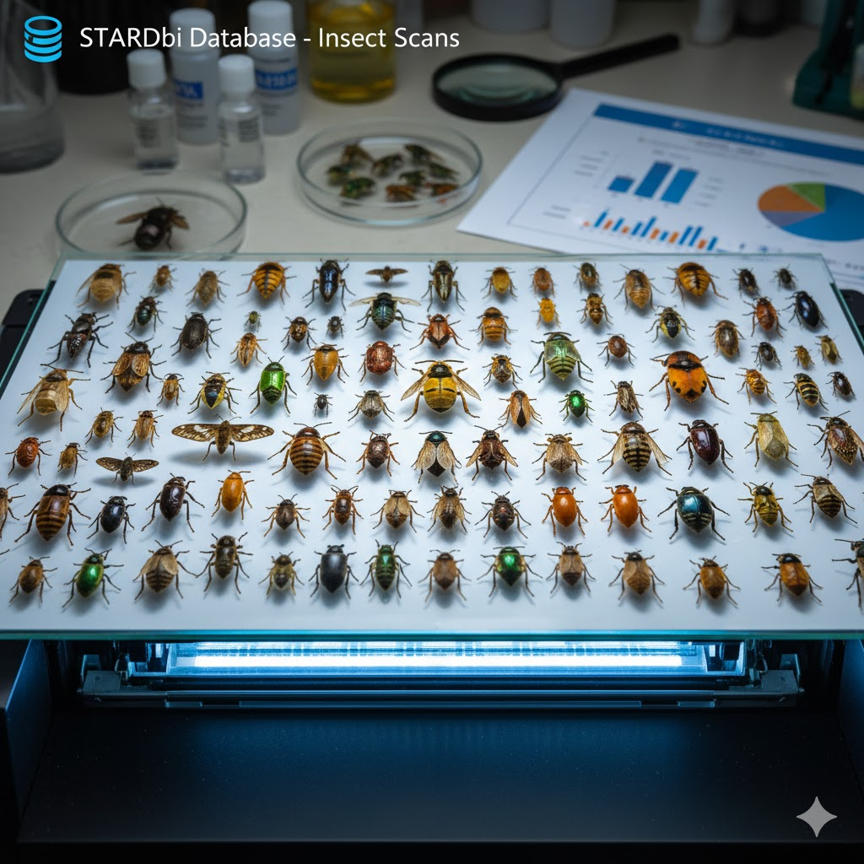
Introduction
Background
The project is part of STARdbi, a large-scale database of insect trap scans.
Each trap captures hundreds of insects from various species and families.
The database currently includes:
Purpose of STARdbi
Support ecology, agriculture, and public health research.
Enable large-scale analysis through object detection and classification models.
Serve as a foundation for multiple ongoing research projects.
1,740 scans from 52 collection sites
Around 350,000 individual insects
Notes:
Some context before presenting the motivation for a mobile app.

Slide 5
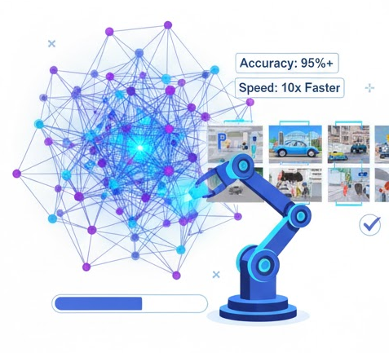
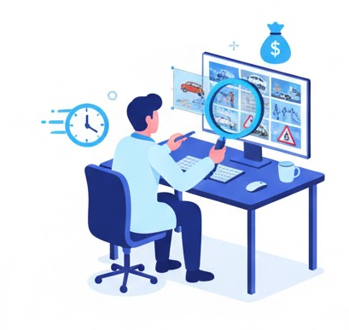
Introduction
Growing Need for Labeled Data
Machine learning models, especially in computer vision, rely heavily on large, accurately labeled datasets.
Collecting and labeling images manually is time-consuming, expensive, and often requires human judgment.

Slide 6
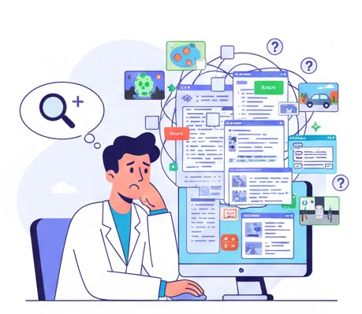
Introduction
Challenges for Researchers
Researchers need more classified data to improve and validate models.
Existing labeling tools are often complex, non-intuitive, or require dedicated time and focus, which limits participation.

Slide 7
Introduction
Challenges for Researchers
Researchers need more classified data to improve and validate models.
Expert labeling is slow, expensive, and resource-intensive.
The labeling bottleneck limits research progress and automation speed.
Existing labeling tools are often complex, non-intuitive, or require dedicated time and focus, which limits participation.

Slide 8
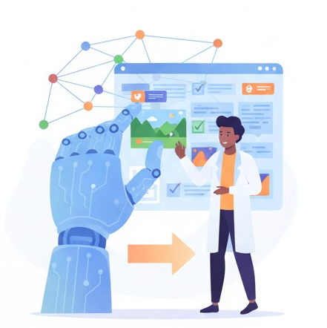
Introduction
Human Input Still Crucial
Despite automation, human perception and intuition remain essential for accurate labeling (e.g., emotions, aesthetics, context).
Making this process easy and accessible encourages more contributions from non-expert users.

Slide 9
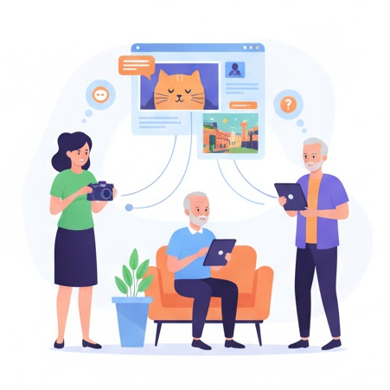
Client Project’s Vision
Create a gamified mobile app (“Tinder for insects”) to accelerate the labeling process.
Enable citizen science: non-experts can contribute to research by performing simple, binary classifications. (e.g., “wasp / not wasp”).
Transform a complex research task into an accessible, engaging experience.

Slide 10





Project’s Motivation
Data-hungry models: Modern computer-vision models require large volumes of high-quality labeled images to improve performance.
Labeling bottleneck: Manual annotation pipelines are slow, expensive, and often inconsistent across annotators.
Low participation: Existing annotation tools are clunky or demanding, so potential contributors (students, volunteers, casual users) don’t spend time labeling.
Human judgement matters: Some labels need human context, nuance, or subjective judgment that automated pipelines can’t reliably provide.
Leverage spare time: Many people have small pockets of free time; a lightweight, enjoyable app can convert that into valuable labeled data for research.

Slide 11




Project’s Purpose
Capture high-quality labeled images by presenting users a fast, simple “Yes / No / I don’t know” workflow.
Scale human annotation by making the process accessible, quick, and game-like to attract more contributors.
Improve ML training data — provide researchers with cleaner, larger, and more diverse labeled datasets for model training and validation.Collect metadata & confidence signals (e.g., time spent, repeated answers) to help weight and filter labels during model training.
Enable iterative research — let researchers push updated models and collect fresh labeled data to evaluate improvements continuously.

Slide 12
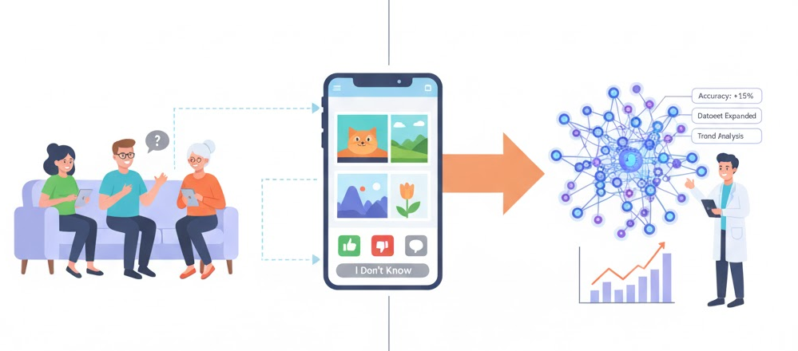


Project’s Purpose
Goal of the Project
To develop an interactive image classification app where users review and categorize reference images with simple “Yes / No / I Don’t Know” options.
The collected responses will help researchers improve model accuracy, expand datasets, and analyze labeling trends.

Slide 13
Project Description
What Will Be Developed
A web/mobile app where users classify reference images with simple choices (Yes / No / I Don’t Know).
A secure backend API that retrieves image datasets and stores labeled results for researchers.
A gamified system that tracks user points, credibility, and engagement.
A research dashboard to analyze results, export data, and monitor label quality.

Slide 14
Project Description
Main Functionality (High-Level)
User interface: Swipe to classify images quickly and intuitively.
Progress & rewards: Points, badges, and leaderboards to motivate participation.
Credibility system: User trust score based on accuracy and consistency.
Dataset API: Secure communication for fetching and submitting classification data.
Research tools: View statistics, consensus levels, and export labeled data.
Quality control: Insert test (“gold”) images to measure accuracy and reliability.
Data protection: Encrypted API access, authentication, and role-based permissions.
Notes:
To provide researchers with a simple, engaging, and secure platform for collecting high-quality human-labeled image data — improving the training and evaluation of AI models.

Slide 15
Customer - what exists? What provides?
Customer’s vision (high-level)
Make their image dataset easy to label at scale by casual users.
Collect reliable human labels to improve model training and evaluation.
Keep dataset access secure while enabling seamless integration with third-party apps.
Enable fast feedback loops: new labeled data should flow back to researchers quickly.
Preserve control & provenance of dataset (who labeled what, when, confidence).

Slide 16
Customer - what exists? What provides?
High-level requirements (what the customer expects)
Secure API access (HTTPS, token-based auth, short-lived credentials).
Stable endpoints to fetch image batches and submit labels (clear request/response schema).
Metadata with images (id, source, existing labels, gold-flag if any).
Label schema (Yes / No / I Don’t Know).
Auditability: logging of submissions (user id, timestamp, elapsed time).
Test / staging environment for integration before production.
Exportable formats for labeled datasets (CSV, JSON, TFRecord).
Quality hooks: support for inserting gold-standard items and reporting flags.
CORS / client restrictions or signed URLs for images to prevent direct scraping.
SLA / uptime expectations and contact for incidents.
Notes:
לוודא מול חן קיסר שאלו כל הדרישות הרצויות בפרויקט

Slide 17
Customer - what exists?
Anything already exists? (likely / desirable items to confirm)
An existing dataset API (endpoints, docs, sample responses).
Image storage with signed URLs.
API docs or at least sample requests/responses.
Notes:
לוודא עם חן קיסר מה קיים

Slide 18
Customer -What provides?
What the customer will provide
API access & documentation (endpoints, schemas, auth flows, error codes).
Dataset ownership & source images (locations, permissions, legal clearance).
Gold-standard subset for credibility calibration (recommended).
Support contact for onboarding / bug triage and an escalation path.
Notes:
לשאול את חן אם יש עוד דברים שנקבל

Slide 19
Project’s Risk Assesment (and how to overcome)
Challenge | How to overcome?
API integration issues - The customer’s API might not fully match our app’s requirements (missing fields, different formats, etc.) | Schedule early technical meetings with the customer to align on the API structure (Michael). Create a shared API spec and test with mock data before full integration.
Communication gaps with the API owner - Misunderstandings or delays in feedback could slow development | Set up regular weekly sync meetings, use a shared communication channel (e.g., Slack/Teams), and maintain clear documentation of integration decisions.
Data security concerns - Sensitive or private dataset access could be at risk | Use HTTPS, token-based authentication, and role-based permissions. Follow customer security guidelines and perform security testing before release.
API downtime or instability | Implement retry logic and caching of fetched images. Maintain error logging and coordinate with the API owner for uptime guarantees.
Integration timeline delays | Use agile sprints, define milestones for API readiness and app testing, and maintain parallel development with mock APIs.

Slide 20
Project’s Risk Assesment (and how to overcome)
Challenge | How to overcome?
Quality of labeled data - Users may classify incorrectly or too fast | Add gold-standard test images, credibility scores, and consensus validation between multiple users to ensure label reliability.
Low user engagement | Use gamification (points, badges, leaderboards) and a clean, intuitive interface to keep users motivated.
Bot users / AI-generated classifications | Implement CAPTCHA or verification steps during account creation Monitor unusual behavior patterns (e.g., too fast swipes, identical answers) Introduce reputation weighting so low-credibility users’ data has less influence Periodically cross-check with gold-standard expert labels to detect suspicious activity
Scalability and performance - Many users labeling simultaneously could overload the system | Design for horizontal scaling and load testing early. Optimize image fetching and caching.
Different environments (staging vs production) | Establish clear environment setup with test credentials and automated deployment scripts to avoid mismatches.

Slide 21
Proposals for User Reliability Scoring
Expert users will have a fixed, predefined influence weight on the model. Non-expert users will have a lower, dynamic weight determined by several factors:
Accuracy on “trap images” (images with known labels).
Average response time: responses faster than a defined threshold will reduce the score.
Consistency: similar “trap” images with the same classification should receive consistent answers.
Self-confidence level (optional): the app may occasionally ask, “Are you sure?”, and factor this into the reliability score.

Slide 22
Proposals for User Reliability Scoring
Comparison to Experts For images that are not trap images, the classifications of expert users will be considered the “reference truth.” The responses of non-experts will be compared to those expert classifications to determine their reliability.

Slide 23
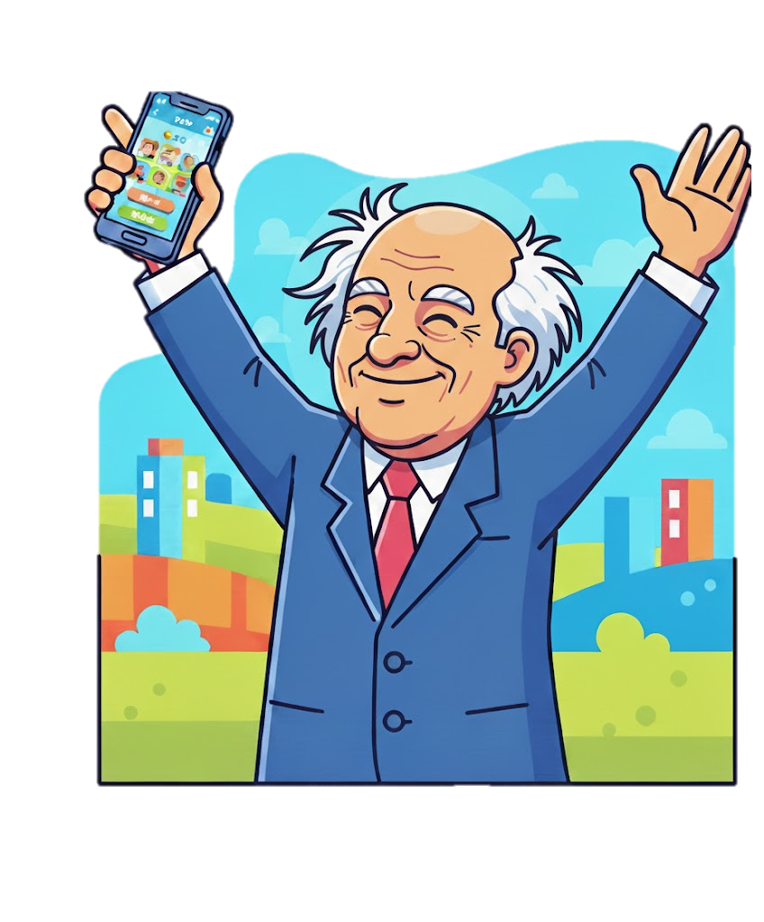
Proposals for User Engagement
Engagement Features
🏆 “LabSwiper of the Week / Month”
Highlight top contributors based on number and quality of classifications.
Display on leaderboard and in the app’s homepage.
🎮 Levels & Tiers System
Users gain experience points (XP) and move up tiers
(e.g., Beginner → Analyst → Expert → Research Partner).
Higher tiers unlock badges and profile icons.
🎁 Rewards & Recognition
Virtual badges, ranks, or small prizes (for research volunteers).
Public acknowledgment in reports or leaderboard screens.
Notes:
Gamification: Users can receive feedback with personal statistics - such as accuracy trends or consistency levels - to increase engagement and awareness of their own performance.

Slide 24
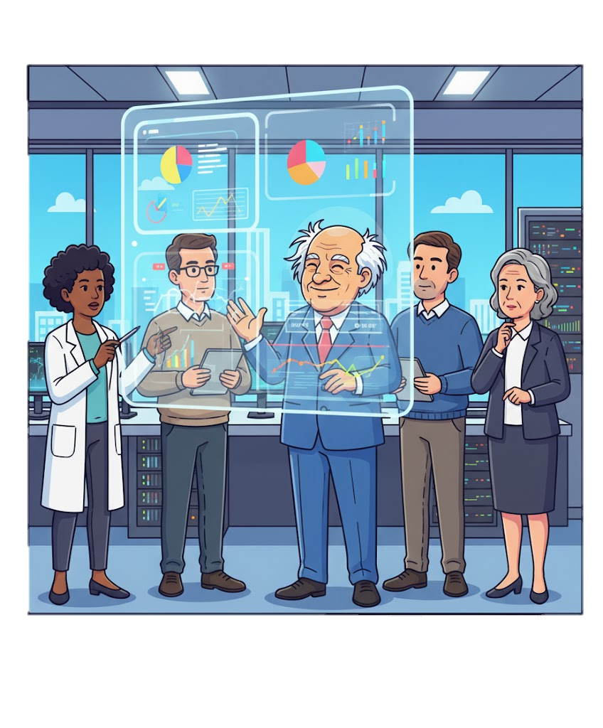
Proposals for User Engagement
Engagement Features
📈 Personal Statistics Dashboard
Show user’s progress:
Number of classifications
Accuracy vs. expert consensus
Total points earned
Time spent and streak days
🤝 Comparison with Experts
Provide insight into how user decisions align with expert-labeled data.
Encourages learning and improvement over time.
Notes:
Gamification: Users can receive feedback with personal statistics - such as accuracy trends or consistency levels - to increase engagement and awareness of their own performance.

Slide 25
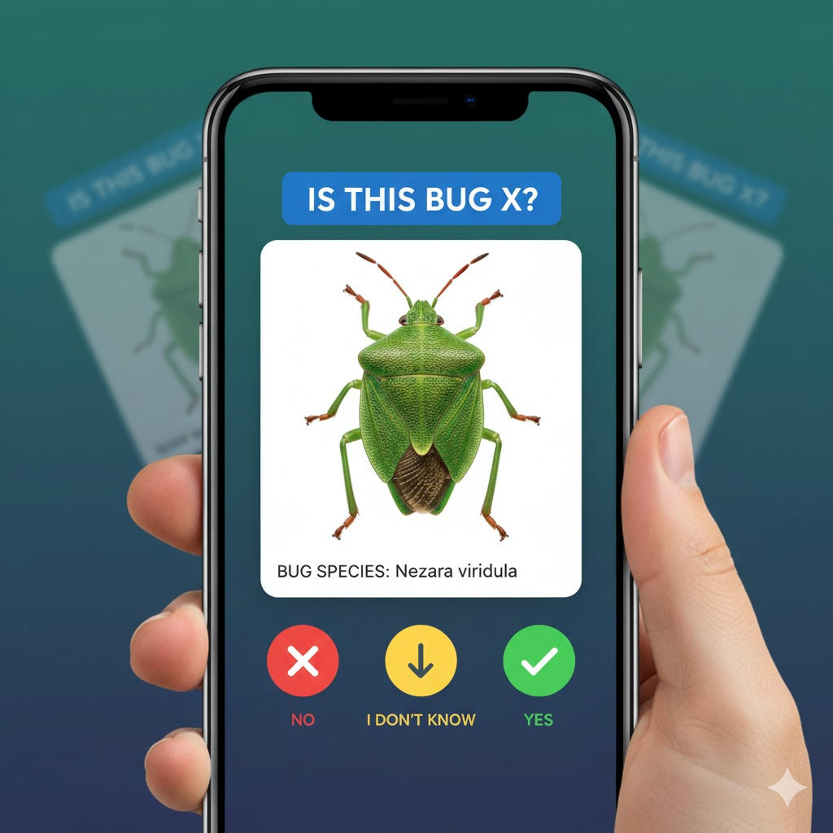
User Interface
Design Goals
Simplicity & speed: users can classify many images in seconds.
Mobile-friendly: optimized for touch/swipe gestures (like Tinder).
Clear feedback: visual confirmation after each choice (Yes / No / IDK).
Engaging layout: progress bar, points, and streak indicators.
Accessibility: large buttons, high contrast, minimal text for universal use.

Slide 26
User Interface
Main Screens
Login / Onboarding: short intro explaining purpose and privacy.
Classification Screen: image displayed with three big buttons - Yes, No, I Don’t Know.
Progress / Points Screen: shows user’s total points, badges, and credibility.
Leaderboard: highlights top contributors and recent activity.
Research Dashboard (admin): overview of labeled data, user stats, and export options.

Slide 27
User Study
Purpose
Evaluate usability, speed, and motivation of users interacting with the app.
Gather feedback on ease of use, visual clarity, and engagement level.
Participants
Small group of students and volunteers (representative of real users).
Mix of tech-savvy and non-technical participants.
Method
Conduct short labeling sessions (5-10 minutes per user).
Collect quantitative metrics: time per image, accuracy, and completion rate.
Collect qualitative feedback: clarity of buttons, fun factor, suggestions.
Expected Outcomes
Verify that the UI is intuitive and efficient for quick labeling.
Identify pain points or confusion to refine design.
Confirm that gamification elements increase engagement and satisfaction.

Slide 28
Project’s Environments and Langugaes
Core Technologies
Frontend: React Native with Expo (cross-platform, mobile-first, fast iteration).
Backend: Java Spring Boot - robust, scalable, and secure REST API framework.
Database: PostgreSQL - relational DB for user data, labels, and statistics.
Authentication: Google Sign-In (OAuth2) integrated with Spring Security.
Deployment: Dockerized microservices hosted on AWS / GCP / Render.
CI/CD: GitHub Actions for automatic testing and deployment.

Slide 29
Project’s Environments and Langugaes
Development Environments
Frontend dev: Expo CLI + Visual Studio Code.
Backend dev: IntelliJ IDEA / Eclipse with Maven or Gradle.
Database management: pgAdmin for PostgreSQL.
API testing: Postman (auto-generated from Spring Boot).
Version control: Git + GitHub (branching workflow).

Slide 30
Project’s Environments and Langugaes
Team Learning Goals
Spring Boot: REST controllers, services, repositories, dependency injection.
Spring Security + OAuth2: secure Google authentication & token validation.
PostgreSQL: schema design, queries, and migrations.
React Native + Expo: UI components, navigation, and API integration.
TypeScript (optional): for front-end type safety.
API integration: learn how to adapt to the customer’s dataset API using secure endpoints.

Slide 31
Project’s Environments and Langugaes
How We’ll Learn
Follow official Spring Boot & React Native tutorials and documentation.
Build small prototypes (auth, simple CRUD) before full integration.
Watch YouTube / Udemy crash courses on Spring Boot + OAuth2 + PostgreSQL.
Conduct pair programming sessions and code reviews to share knowledge.
Use mock APIs early, then connect to the real dataset API once stable.
Practice deployment and testing with Docker containers on local/staging environments.

Slide 32
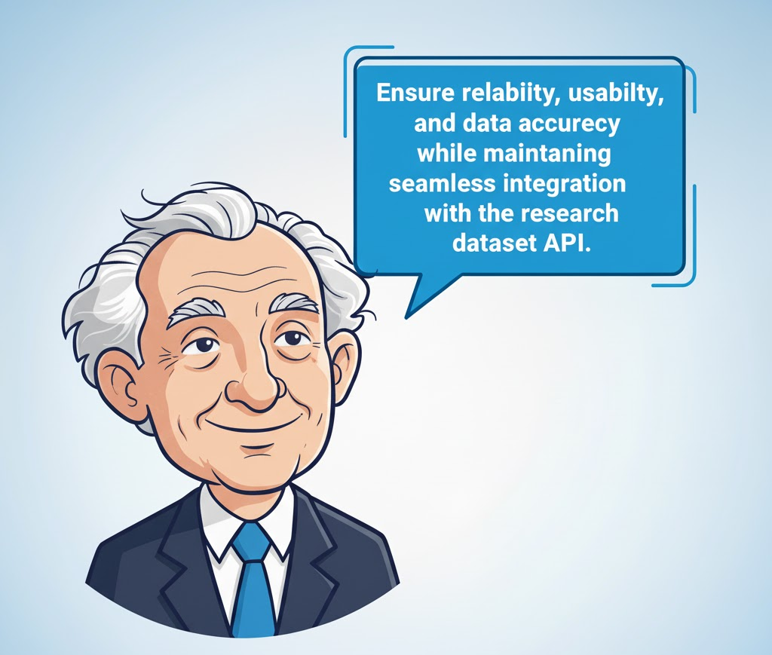
Evaluation and Testing Plan
Unit Testing -Each component (frontend and backend) will be tested individually to ensure correct behavior and stable functionality.
Integration Testing -Verify smooth communication between the mobile app, backend server, and external API (dataset provider).
API Testing -Ensure secure and reliable data exchange with the customer’s API, validating authentication and data integrity.
UI/UX Testing -Evaluate usability, design clarity, and user flow to make sure the app is intuitive and engaging.
Performance Testing -Test responsiveness, loading speed, and scalability under multiple concurrent users.
User Acceptance Testing (UAT) -Conduct a pilot with real users (researchers) to confirm the system meets expectations and is ready for deployment.

Slide 33
Project’s Steps and Timeline
Use draw.io to describe a block diagram of the project steps, and in addition a chart of the timeline
Phase | Duration | Description
Requirement Analysis | Week 1 | Define project scope, requirements, and API adaptation with customer
UI/UX Design | Weeks 2-3 | Design app wireframes and user flow
Backend Development | Weeks 4-6 | Build server, connect to dataset API, handle authentication
Frontend Development | Weeks 6-9 | Implement React Native app with swipe interface
Testing & Debugging | Weeks 10-11 | Perform unit, integration, and usability tests
User Evaluation & Feedback | Week 12 | Pilot test with researchers
Final Delivery & Presentation | Week 13 | Final adjustments and presentation demo

